Slide 1
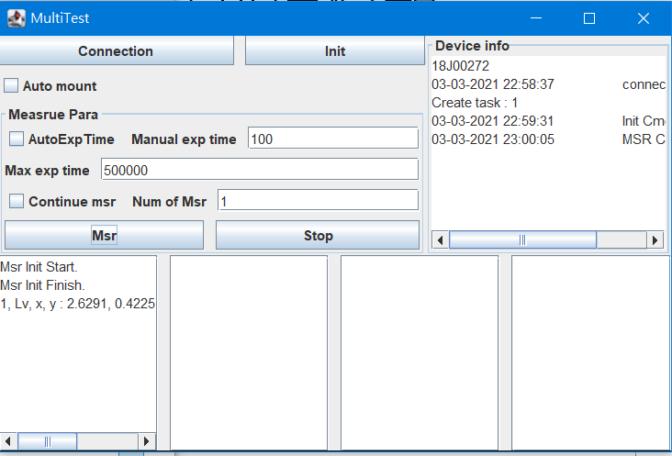
1
2
3
Measurement Setting
Step 1: after plugin device and “Connection”
Step 2: “Init”, dark calibration
Step 3: “Msr” & number of measurement

